Slide 1
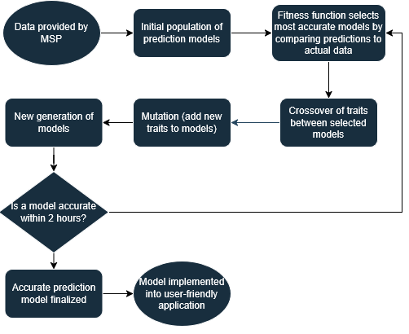
Genetic algorithm
Aden Kim, Heena Parekh, Bill Zhou, Yi Ping
features
Description: Iterates through generations of models or "species" and selects the most effective traits to pass on
Pros:
Strong global optimization ability and less sensitive to noise in data
Fits the data provided well since the relationship with installation times might not be linear
Large range of application
Not as difficult to create as a neural network, but also more complex than linear regression
Cons:
High computational cost
Dependence on fitness function

